Slide 1
DEPRESSION DETECTION USING MACHINE LEARNING
AND NATURAL LANGUAGE PROCESSING

Slide 2
Project Team : 5
Under the guidance of : Prof. A. S. N. Chakravarthy
Team Members :
S.No | Reg no. | Name
1 | 17VV1A0524 | M. Jahnavi
2 | 17VV1A0547 | T. Sowmya
3 | 16VV1A0517 | G. Raj Sankeerth
4 | 17VV1A0538 | Sandeep. A

Slide 3
Contents
Problem statement
Workflow
Data Collection
Data Cleaning
Preprocessing
Model Building
Prediction Generation

Slide 4
Problem Statement :
The goal was to implement a deep learning model that captures and analyses linguistic markers associated to the onset and persistence of depressive symptoms in order to develop a predictive algorithm for depression.
To advance the concept of using linguistic markers in Tweets to build statistical models that can identify and even predict depression.

Slide 5
Workflow :
Data Collection
Data Cleaning
Text Preprocessing
Model Building
Generating Predictions

Slide 6
Data Collection :
Scraped tweets for a random 24 hour period using TWINT tool containing the words depressed, depression, antidepressant, suicide, hopeless, mental health.
Random (positive) data from the Sentiment140 dataset is added to this dataset. This text data is further cleaned and preprocessed.

Slide 7
Data Cleaning :
Remove URL links
Remove tweets with <6 chars and <2 words
Remove punctuations, hashtags, emojis, @mentions, image URL links
Remove special html entities. E.g.: &amp;
Remove whitespaces
Expand contractions. E.g.: I've -> I have
Fix weirdly encoded texts
Tokenize and remove stopwords

Slide 8
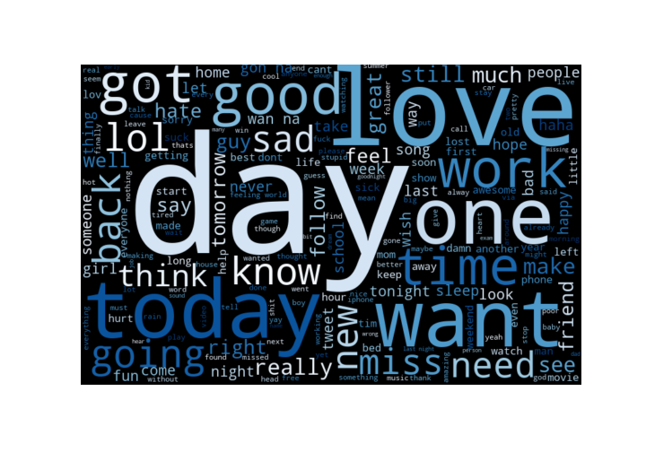
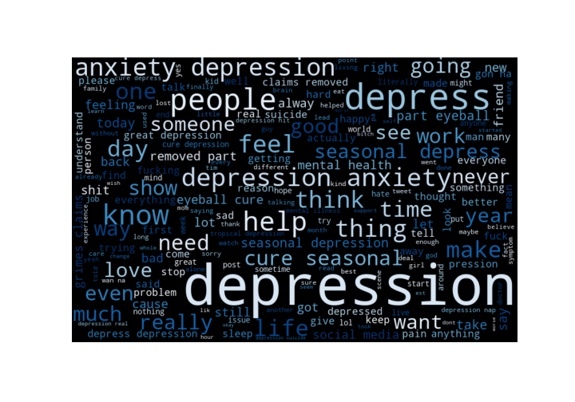
Data Cleaning (contd.):
Generated word clouds

Slide 9
Preprocessing :
Tokenization with num_words set to 25000
Convert the text to sequences
Pad the sequences to have same length
Compute the embedding matrix

Slide 10
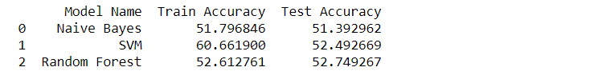
Model Building :
Trained the dataset using 3 ML algorithms:
Naive Bayes
SVM
Random Forest

Slide 11
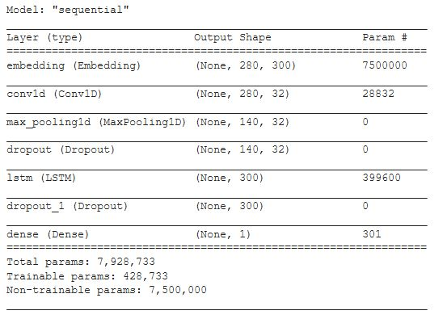
Model Building (contd.):
Deep learning model: containing 3 layers - Embedding layer, Convolutional layer, LSTM layer.

Slide 12
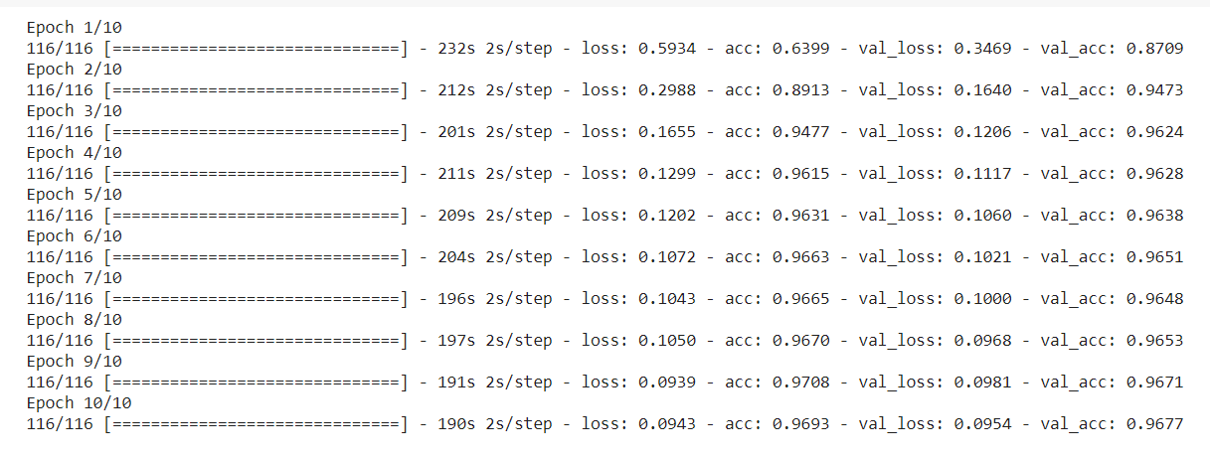
Network is trained for 10 epochs

Slide 13
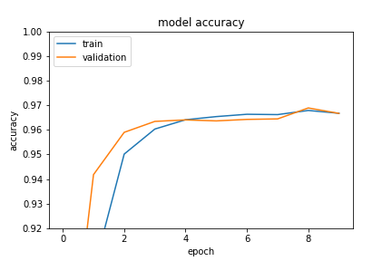
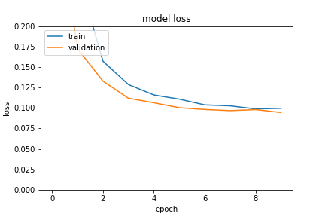

Slide 14
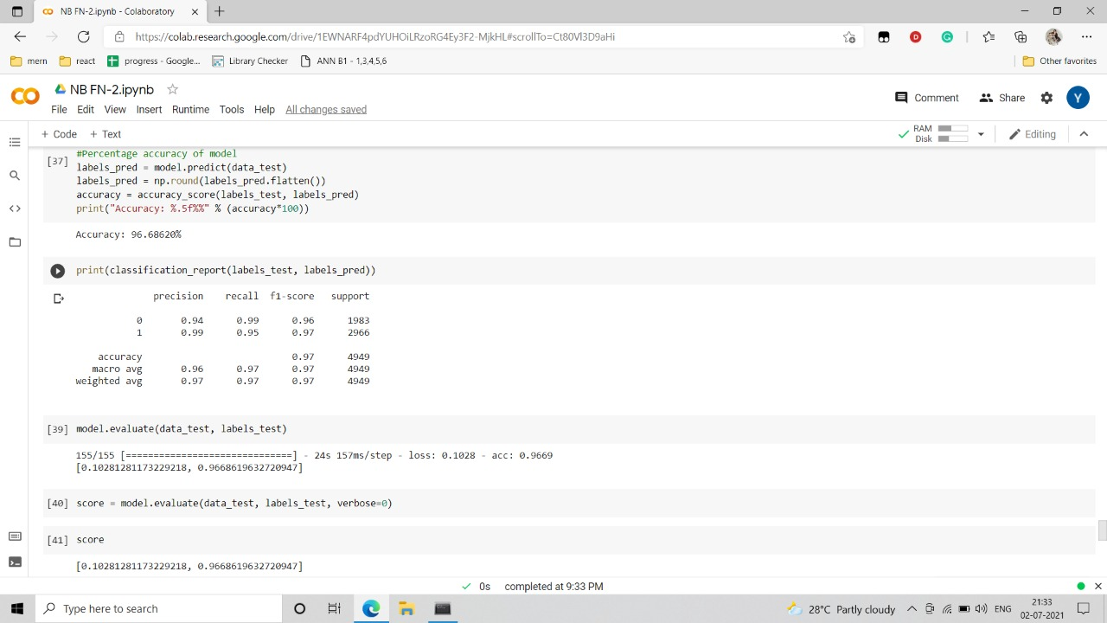
Classification Report
Evaluation Score

Slide 15
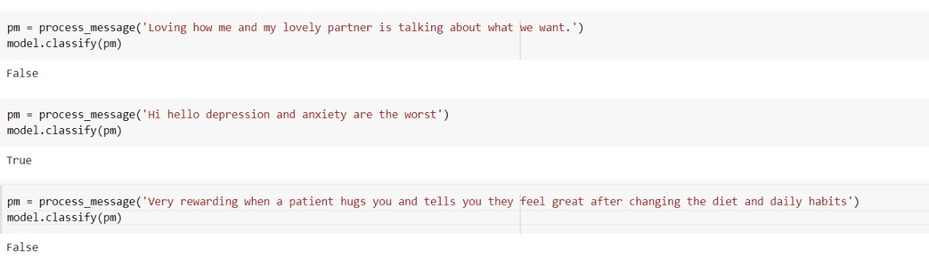
Predictions :

Slide 16
Thank You

